Slide 1

IAD/Blockchain project update 16/09/2021
Stefan roata

Slide 2
1. Integrating the manually scraped data from marco
I looked at the manually scraped data and it seemed similar to the other texts that the scraper has collected, so we’re good in that sense.
I still had to clean it though: I had to remove the empty rows and populate the organization column fully ☺ . Moreover, I had to remove all the newline characters that were literally everywhere in the text (not Marco’s fault).
I merged the cleaned data in the Excel file with the rest of the data in the csv file so that now, we have a complete corpus of documents that has at least one text/website for each organization (also available on the Google Drive).

Slide 3
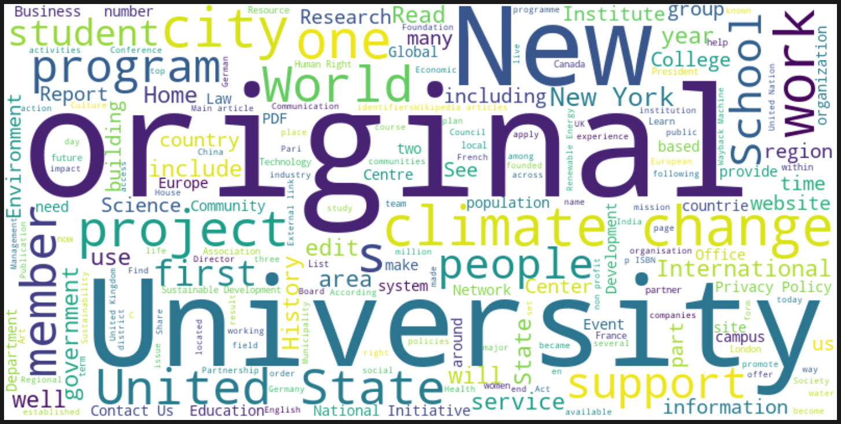
2. Having gotten all the data, I re-did all the previous visualizations (available on google drive)

Slide 4
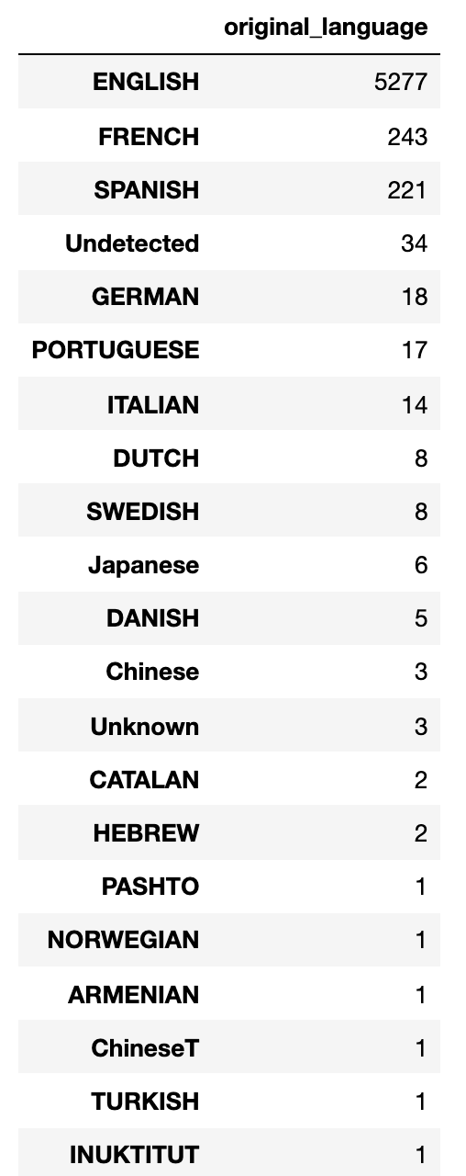
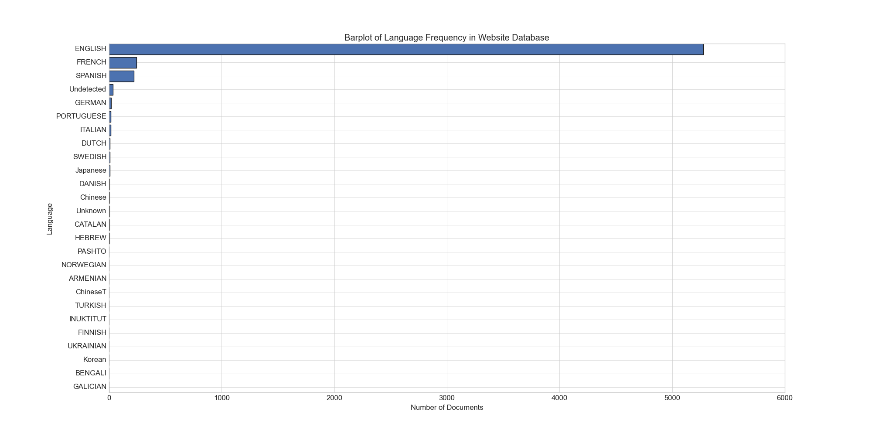
3. Language detection and translation

Slide 5
4. Language detection problems (help please)
I tried multiple python language detectors/translators and ran into a bunch of problems:
spacy – this is the one I tried first, and I barely got it to work, because one recent update of this package ruined the usual syntax of the language detector object instantiation (to be read as, the code I found online is not applicable anymore ☹); nevertheless, I found a way around it, and I could use it, but it’s moving really slow
textblob – this was the easiest to use, but I encountered an error that I could not fix (other people are having the same problem too); basically, this package sometimes calls this remote server via HTTP but sometimes, the connection is bad and I get a 404 or 405 error. To date, there is no way to work around this, I just have to wait and hope that the connection to the server will just … fix itself?
pycld2 – the only package that is actually running properly!! I generate the language detection data using this one. It is fast, but not so reliable: 34 websites contain some non-UTF8 characters (which is really weird), so they could not be translated. Furthermore, the package was not able to infer the language of another 3 websites (not because of the UTF encoding in this case). We might have to fill those manually.
Google translate package: I heard it’s better and faster than the others, but I also got word of some translation reliability problems (Brendan?) – should I be using this instead of pycld2 or not?
I am open to suggestions about this. I will also ask Xuewei for some recommendations on this.

Slide 6
5. Let’s talk about sentences (and tokenizing text into sentences)
I heard your concerns about generating a lot of ”garbage” data, and I agree, but I don’t think that splitting it into sentences would cut it for 3 main reasons:
1. Most sentence tokenizer work just like regular expressions, and they are unlikely to realize that the first 20+ words of a text of ours are actually not part of a sentence. Take, for example, the nltk sentence tokenizer that is pre-trained and state-of-the-art (at least for Python). I tried it and… the result looks disappointing:

Slide 7
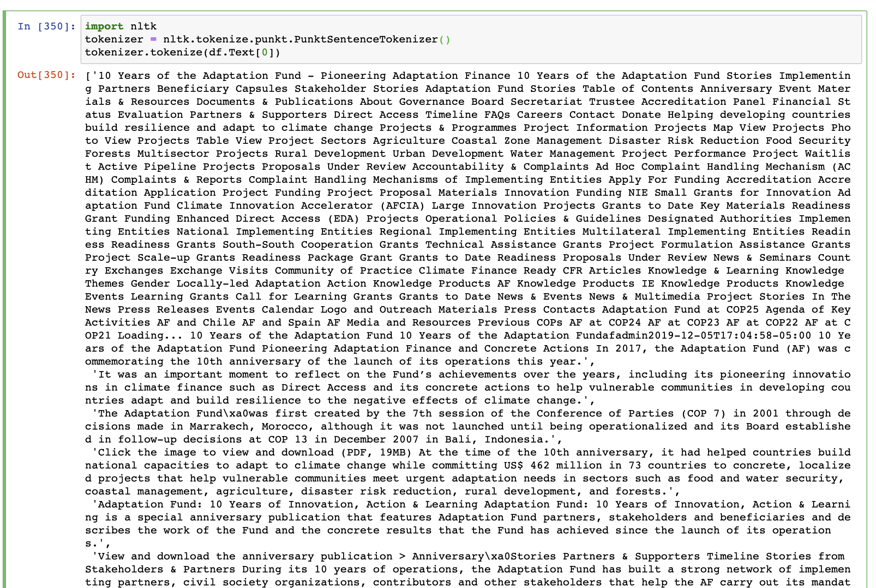

Slide 8
5. Let’s talk about sentences (and tokenizing text into sentences)
2. Second reason is what I already mentioned on Slack, and I still stand by this: a necessary step before running LDA is to strip all text (including the full sentences!!) of their words and put them in a sort of dictionary where each key represents a particular word, and each value the frequency of that particular word in the text.
In short, LDA pre-processing gets rid of the sentence (or sentence-like) structures anyway by splitting them up into their components.
So I wouldn't worry about the difference between texts in sentences and texts not in sentences for the purposes of our task.
3. If we only keep the text that is grouped into sentences, we risk losing some organizations along the way. If some organizations only have 2-3 websites, it is possible that none of the information on those websites is grouped into sentences.

Slide 9
Brendan’s suggestions
One possibility is to use a package that identifies sentence syntax to make sure that we only keep sentences that contain some minimum criteria (noun, verb, adjective, etc.) – COMMENT: a lot of POS taggers would still consider unconnected words as valid parts of speech (e.g. Take the beginning of a landing page: “About Us Contact Climate Policy …” would still be classified as ‘Preposition Pronoun Noun Noun’ or something similar, even though this is not a valid sentence!
Another possibility would be to only keep text strings that follow a capitalization pattern - so something like grabbing text only where a string with the first letter capitalized is followed by other strings with no capitalization (before a sentence identifier, like ".") – COMMENT: I like this idea, but what about a sentence like:
“Therefore Singapore is a very modern city”.

